Slide 1
Medicine:
Heart Disease Analysis and Detection
DSC 680
Adrian Rybinski

Slide 2

Table of Contents
Introduction/Problem Statement 3
Team Objective/Mission Statement 4
Health Conditions Analysis 5 – 6
Data Analysis 7 – 9
Observations and Results 10 – 11
Risks and Opportunities 12
Questions/Answers Session 13
References 14

Slide 3



Introduction/Problem Statement Why are we pursuing this project?
Even with medical technology advancements, the medical community is under constant pressure to do more and provide more accurate results.
The focus is not longer to detect but prevent disease.
Heart disease continues to be the deadliest conditions for the American population

Slide 4


Team Objective/Mission Statement What we want to do?
Determine the best variable for heart disease detection/predictions
Design a sustainable model for heart disease predictions
Distribute the model for wide use in the medical and fitness communities

Slide 5
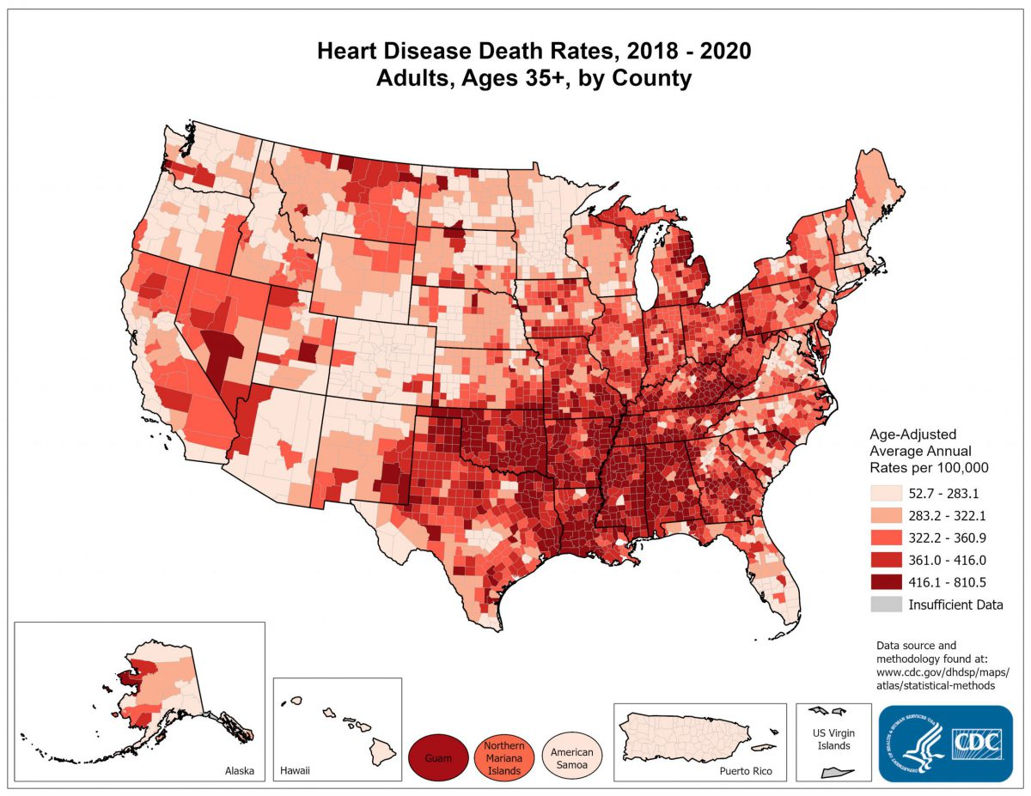
Health Conditions Analysis Where are we now?
Heart disease is the leading cause of death in the United States
One person dies every 34 seconds in the United States from cardiovascular disease
About 697,000 people in the United States died from heart disease in 2020
Heart disease costs the United States about $229 billion each year

Slide 6
Health Conditions Analysis (continued) Where are we now?
Race of Ethnic Group | % of Deaths | Male, % | Female, %
America Indian or Alaska Native | 14.2 | 15.5 | 12.7
Asian | 18.9 | 20.0 | 17.8
Black (Non-Hispanic) | 20.7 | 21.0 | 20.3
Native Hawaiian or Other Pacific Islander | 20.8 | 21.9 | 19.4
White (Non-Hispanic) | 21.3 | 22.7 | 19.8
Hispanic | 15.8 | 15.8 | 15.8
All | 20.6 | 21.6 | 19.5
More than One Race | 18.2 | 19.2 | 16.9
Heart disease is the leading cause of death regardless of race, ethnicity, or gender
People of most racial and ethnic groups in the United States are heavily impacted

Slide 7

Data Analysis What was done so far.
For the purposes of the model development, we have completed the following:
Obtained 1025 medical records from various sources on heart conditions
Analyzed data correlations
Cleaned/removed unused data
Developed categories for visualizations
Prepared data to be binary values for model fitting

Slide 8
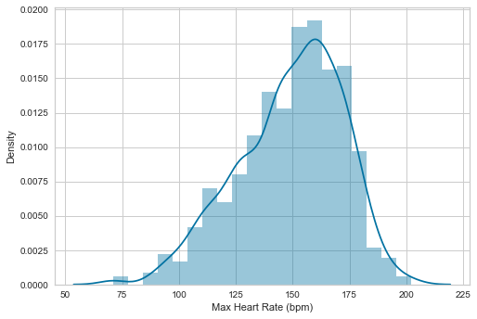
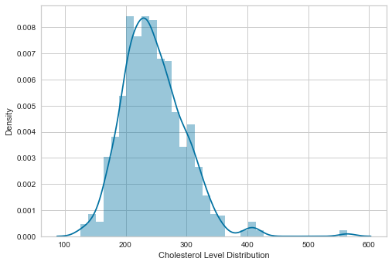
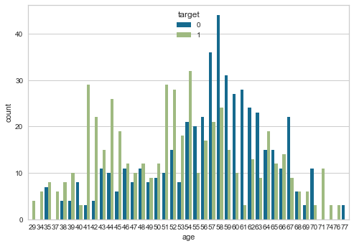
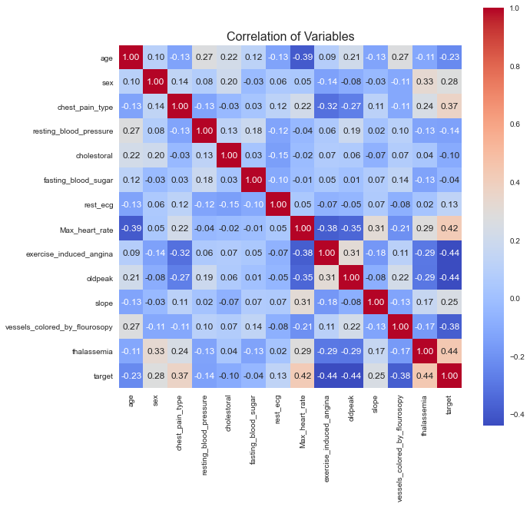
Data Analysis (continued) What was done so far.
For the purposes of the model development, we have uncovered the following patterns and insights:
Age was indicating a contrary results as compared to medical guidance. In our date younger people were more likely to have heart disease.
Cholesterol and high heart rates were inline with assumptions.
Data distribution was also inline for Heart rates showing higher rate being a factor in heart disease.
Our data set also indicated that the population of patients had a level distribution for cholesterol levels which we thought would be more skewed to the higher range but was not.
No one variable had a significant correlation with heart disease

Slide 9
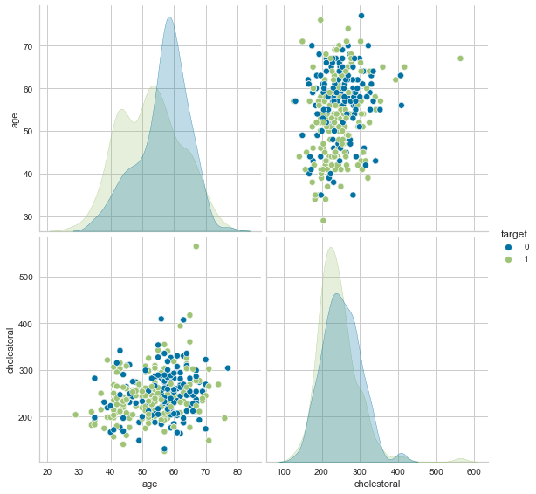
Data Analysis (continued) What was done so far.
There were very few outliers in the main data elements which solidified our choice of data
The overall distribution of age and heart disease was inline but eventually discarded
All other variables were within set parameters for this project

Slide 10
Observations and Results How did we do?
The results far exceeded expectations
The accuracy of the all-variables model reached as high as 95%
The accuracy for the truncated data model did not outperform the former reaching accuracy levels of 72%
Additional data records are needed for enhancements/calibration
 | All Variables Model |  | Truncated Data Model
Model/Algorithm | Score | Standard Deviation | Score | Standard Deviation
Logistic Regression | 0.762195 | 0.044725 | 0.721951 | 0.049024
Linear Discriminant Analysis | 0.769512 | 0.057057 | 0.723171 | 0.049702
K Neighbors Classifier | 0.809756 | 0.040520 | 0.696341 | 0.054932
Decision Tree Classifier | 0.928049 | 0.019244 | 0.713415 | 0.052947
Gaussian Naïve Bayes | 0.769512 | 0.049821 | 0.709756 | 0.044575
Linear Support Vector Classifier | 0.768293 | 0.057200 | 0.723171 | 0.049702

Slide 11
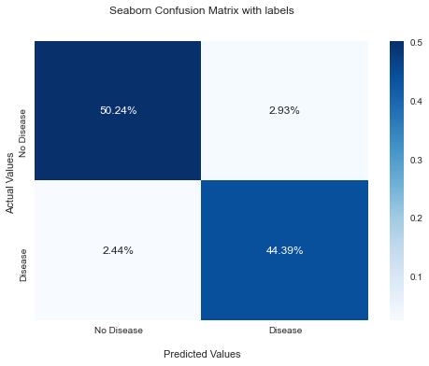
Observations and Results (continued) How did we do?
The Decision Tree Classifier has been selected as the optimal solution
Acceptable accuracy on both detection of the disease as well as determination that there is no disease present
Propose to move the model into clinical trials to observe the effectiveness of the predictions
 | Precision | Recall | F1-Score | Support
No | 0.95 | 0.94 | 0.95 | 109
Yes | 0.94 | 0.95 | 0.94 | 96
Accuracy |  |  | 0.95 | 205
Macro Avg | 0.95 | 0.95 | 0.95 | 205
Weighted Avg | 0.95 | 0.95 | 0.95 | 205

Slide 12


Project Risks and Opportunities How are we going to improve?
Possible disparity if demographic data is included in the model even though medical institutions do focus on race/ethnicity impacts
Address possibility of determining if lack of correlation between variables and target can be improved or needed
Adoption may be limited if no clinical trials done

Slide 13

Questions and Answers

Slide 14
References Where is the data coming from?
Center for Disease Control and Prevention. Heart Disease Facts. Retrieved from https://www.cdc.gov/heartdisease/facts.htm on October 20, 2022
Kaggle. Heart Disease Dataset UCI. Retrieved from https://www.kaggle.com/datasets/ketangangal/heart-disease-dataset-uci on October 15, 2022

